Slide 1
Pose Estimation in Heavy Clutter using a Multi-Flash Camera
Ming-Yu Liu, Oncel Tuzel, Ashok Veeraraghavan, Rama Chellappa, Amit Agrawal, and Harushisa Okuda

Slide 2
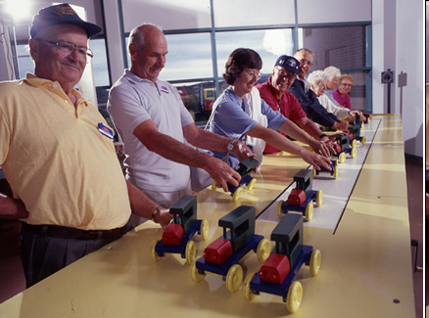
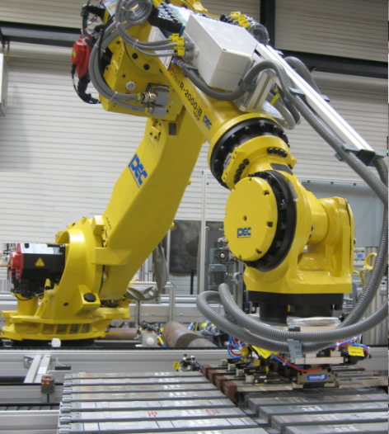
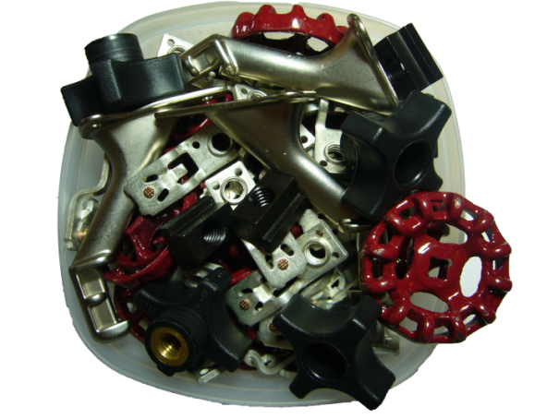
Object Pose Estimation for Robot Assembly Tasks
Human Labor
to Robot Labor
Objects must be
carefully placed before
robot operates
Invention of interchangeable parts
How about this?
Computer Vision Based Solution
The goal is to detect and localize a target object in a cluttered bin and to accurately estimate its pose using cameras. The robot can then use this estimate to grasp the object and perform subsequent manipulation.

Slide 3
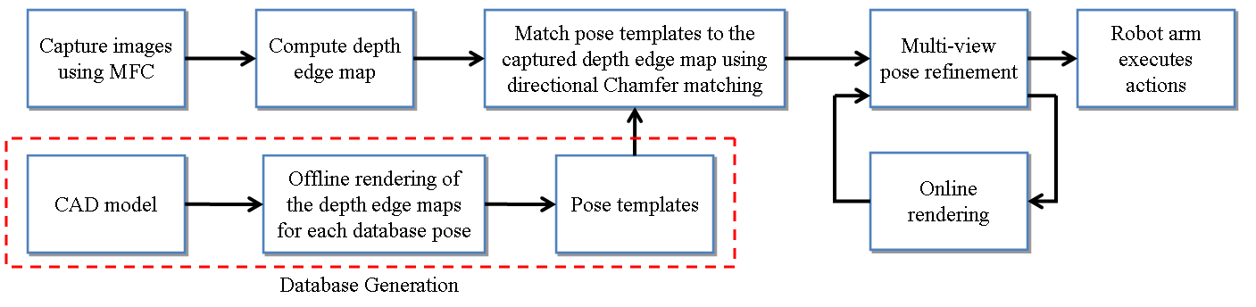

System Overview
Algorithmic Layout

Slide 4
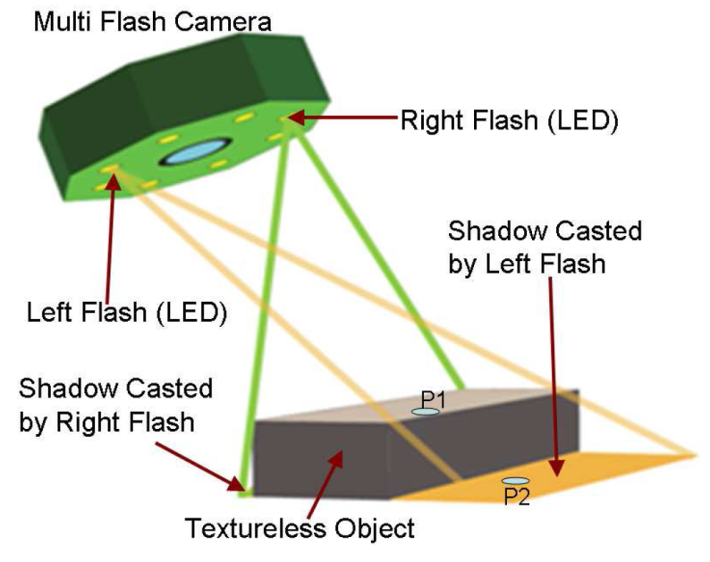
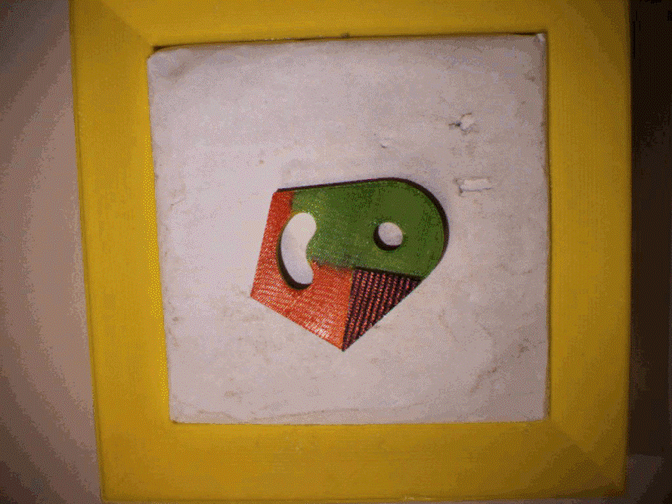
Multi-Flash Camera
LEDs are sequentially switched on and off to create different illumination patterns.
We filter out the contribution of ambient light by computing J_{i} = I_{i} – I_{ambient}
We normalize the illumination changes by computing ratio Images RI_{i} = J_{i} / J_{max}
Detect the bright to dark transition in the ratio images

Slide 5
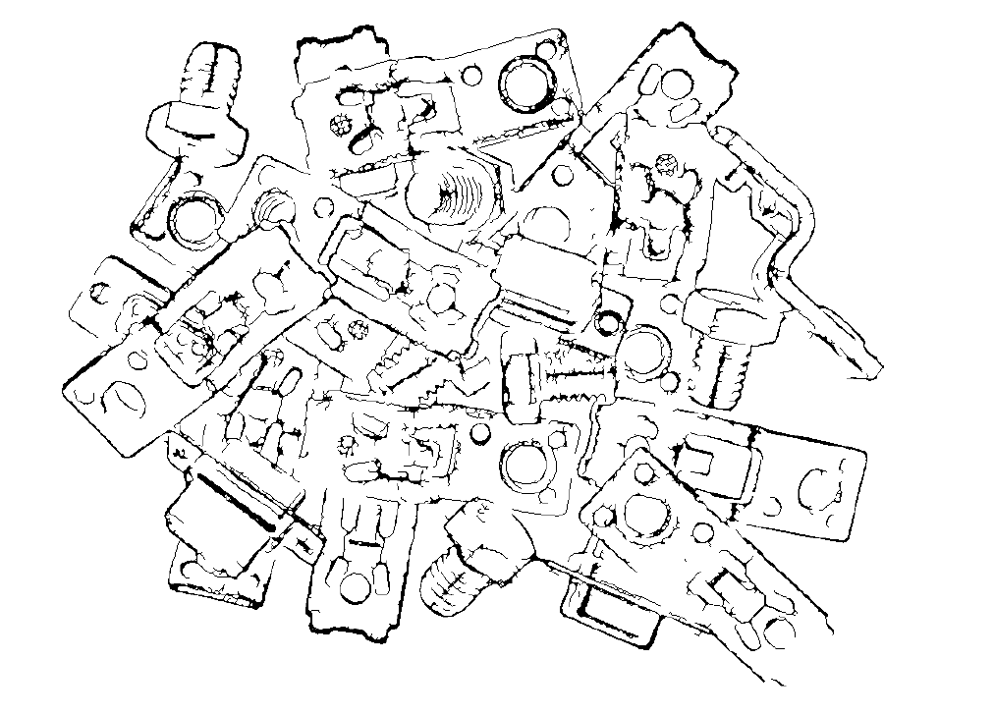
Depth Edges
Edges detection
using Canny
edge detector
Depth Edges
Using MFC

Slide 6
Database Generation
The database is generated by rendering the CAD model of the object with respect to sampled 3D rotations at the fixed location.
We sample k out-of-plane rotations uniformly on the space and generate the depth edge templates.
We exclude inplane rotations from the database and solve for the optimal
in-plane rotation parameter during matching

Slide 7
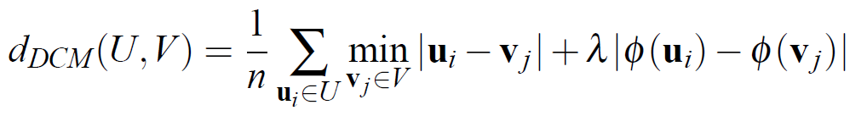
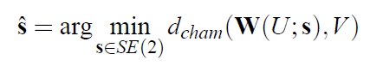
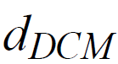
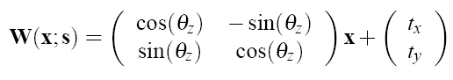
Directional Chamfer Matching
We define the distance between two sets of edge maps as
and solve for the optimal alignment parameters
where

Slide 8
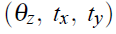
Search Optimization
The search problem requires optimization over three parameters of planer Euclidean transformation, , for each of the k templates stored in the database
Given a 640x480 query image and a database of k = 300 edge templates, the brute-force search requires more than 10¹⁰ evaluations of the cost function
We perform search optimization in two stages:
We present a sublinear time algorithm for computing the matching score
We reduce the three-dimensional search problem to one dimensional queries

Slide 9
Line Representation
We fit line segments to depth edges and each template pose is represented with a collection of m-line segments
Compared with a set of points which has cardinality n, its linear representation
is more concise
It requires only O(m) memory to store an edge map where m << n
We use a variant of RANSAC algorithm to compute the linear representation of an edge map

Slide 10
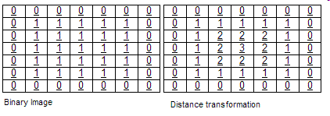
3D Distance Transform
Distance Transform
Distance transform is an intermediate image representation where the map labels each pixel of the image with the distance to the nearest zero pixel.
3D Distance Transform
The 3D DT can be computed in linear time on the size of the image using
dynamic programming
Given the DT the matching cost can be evaluated in O(n) operations where n is the number of template edge pixels.
Input Image
Quantization
2D
Distance
Transform
3D
Distance
Transform

Slide 11
Directional Integral Images
Summing the cost for each edge pixel still requires O(n) operations
It is possible to compute this summation for all the points on a line in constant time using directional integral images
We compute 1D directional integral images in one pass over the 3D distance transform tensor
Using the integral representation the matching cost can of the template at a hypostatized location can be computed in O(m) operations where m is the number of lines in a template and m << n
Integral
Distance
Transform

Slide 12
1D Line Search
The linear representation provides an efficient method to reduce the size of the search space.
We rotate and translate the template such that the major template line segment is aligned with the direction of the major query image line segment. The template is then translated along the query segment.
The search time is invariant to the size of the image and is only a function of number of template and query image lines.

Slide 13
Pose Refinement
The scene is imaged with MFC from a second location
We jointly minimize the reprojection error in two views via continuous optimization (ICP and Gauss-Newton) and refine the pose

Slide 14
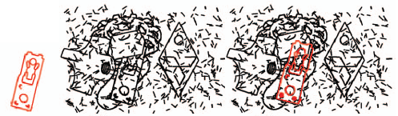
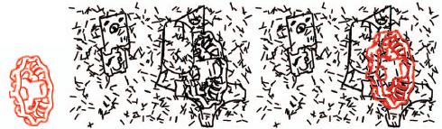
Experiments on Synthetic Data
Pose estimation in heavy clutter
Detection performance comparison
Detection Rate | Circuit Breaker | Mitsubishi Logo | Ellipse Toy | T-Nut | Knob | Wheel | Avg.
Propsed | 0.97 | 0.99 | 0.95 | 0.89 | 0.96 | 0.92 | 0.95
OCM [1] | 0.95 | 0.95 | 0.86 | 0.83 | 0.96 | 0.83 | 0.90
Chamfer Matching [2] | 0.89 | 0.78 | 0.74 | 0.66 | 0.74 | 0.78 | 0.76
[1] J. Shotten, A. Blake, and R. Cipolla. Multiscale categorical object recognition using contour fragment, PAMI 2008
[2] H. G. Barrow, J. M. Tenenbaum, R. C. Bolles, and H. C. Wolf, "Parametric correspondence and chamfer matching: Two new techniques for image matching," in Proc. 5th Int. Joint Conf. Artificial Intelligence 1977

Slide 15
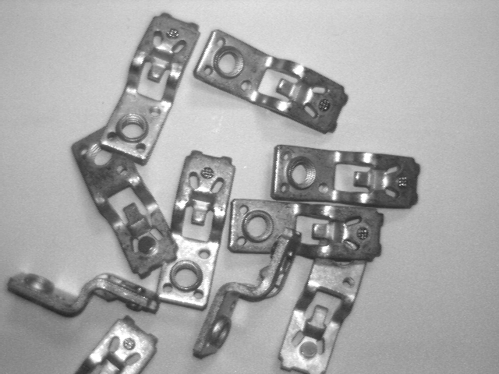
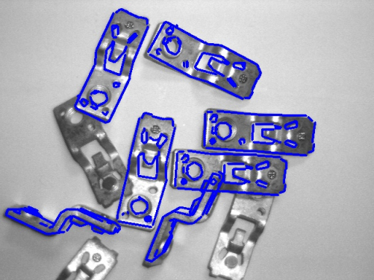
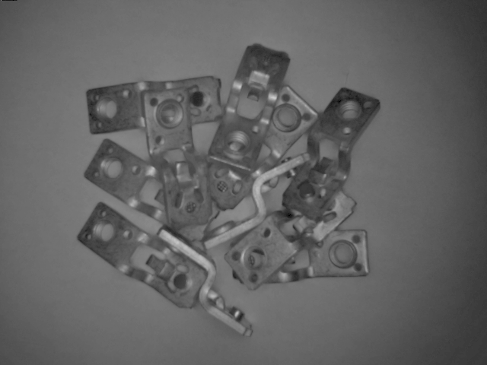
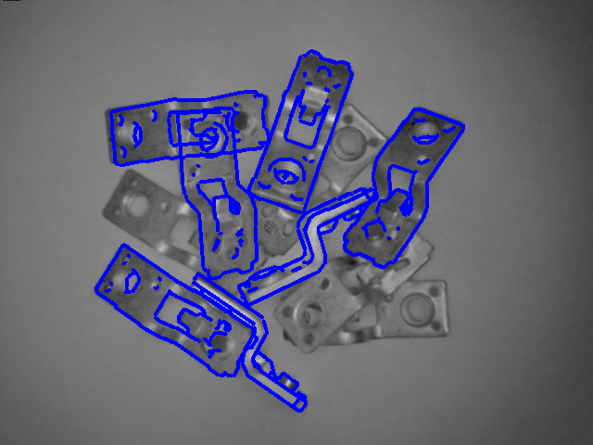
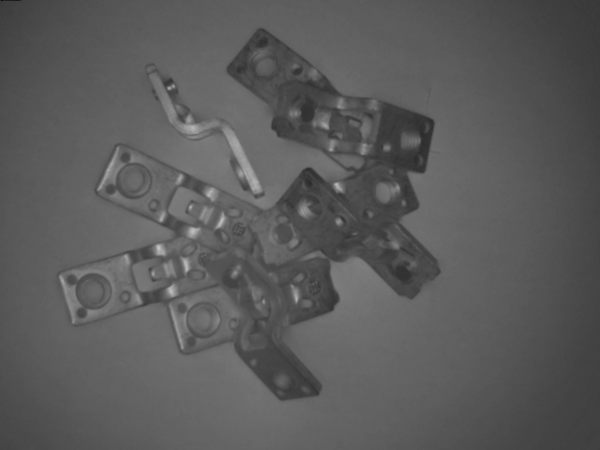
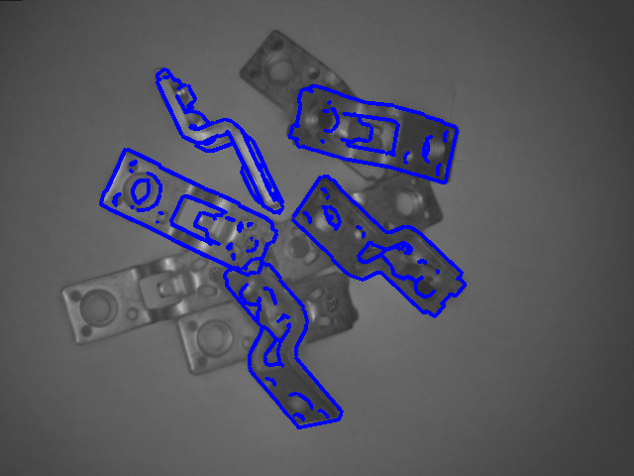
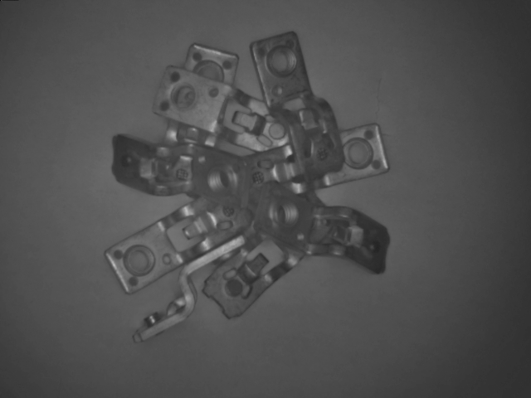
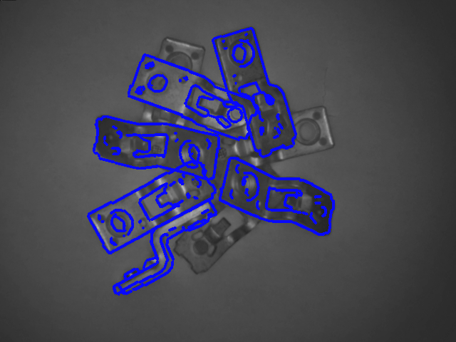
Experiments on Real Data ( Matching )

Slide 16
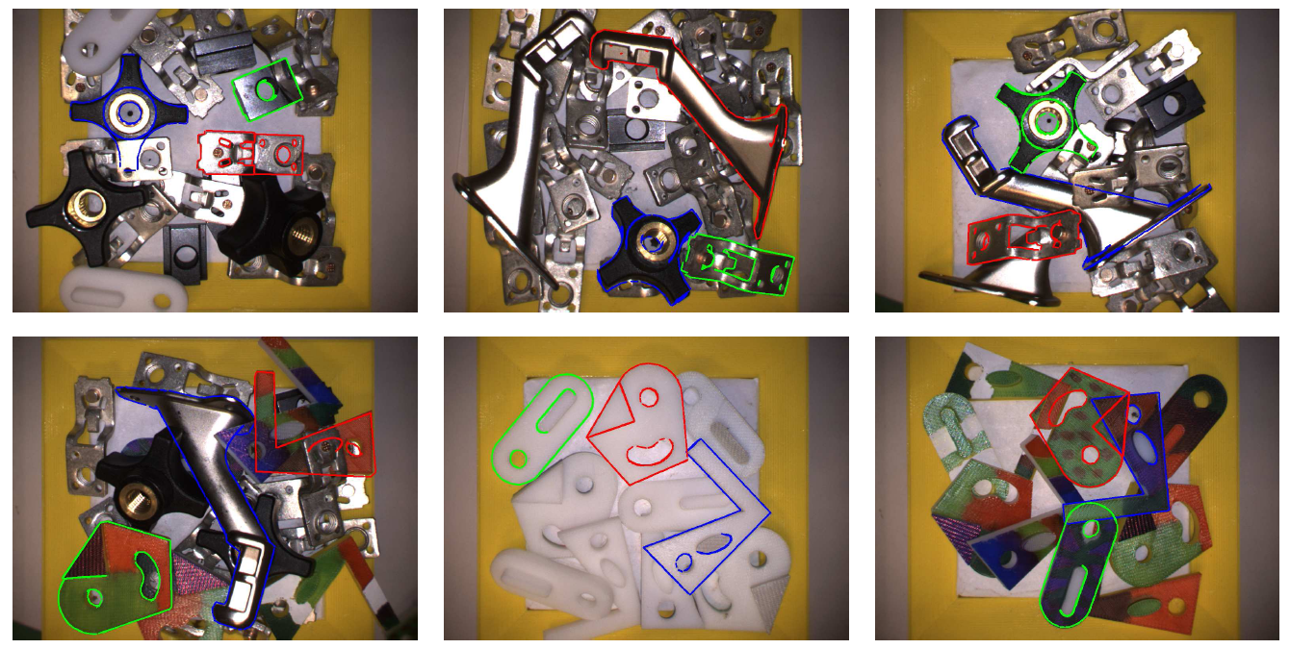
Experiment On Real Data ( Pose Refinement )

Slide 17
Pose Estimation Performance on Real Data
Normalized histogram of deviation from pose estimates to their medians

Slide 18
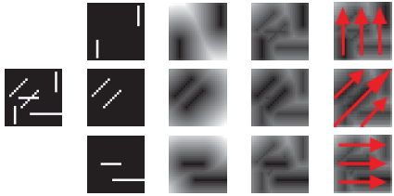
Conclusion
Multi-Flash Camera provides accurate separation of depth edges and texture edges and can be utilized for object pose estimation even in heavy clutter.
Directional Chamfer Matching cost function provides a robust matching measure for detecting objects in heavy clutter.
Line representation, 3D distance transform, and directional integral images enables efficient template matching.
Experiment results show that the proposed system is highly accurate. ( 1mm and 2⁰ )

Slide 19

Thank You & System Demo

